Slide 1
Warm-up
Who (which group of people) needs to agree to a treaty that the President negotiates?
Under what circumstances can someone be impeached?
Name one Constitutional power (look at Article 2 if you forgot these) that the President has.

Slide 2
Warm-up
List all the roles of the president. (HINT: look at the worksheet from last Tuesday).
DO NOT turn in your warm-up when you finish! Just keep it at your desk until we do the next activity.

Slide 3
Quiz on Congress
Review for 3 minutes before we take the quiz about the powers of Congress.

Slide 4
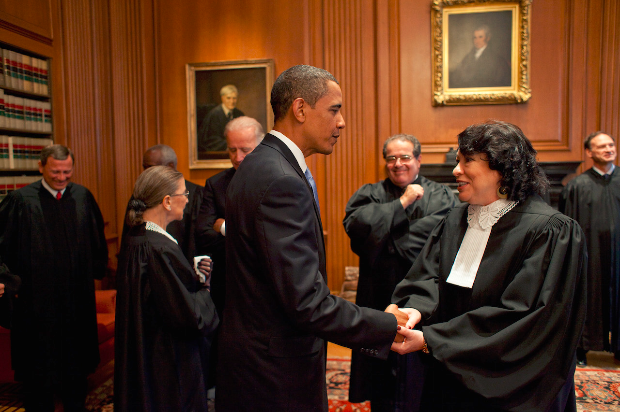
Presidential Powers: Legislative, Judicial, Diplomatic, Military
Unit 5
Notes:
The presidency is regularly called “the most powerful office in the world,” and it is. However, is this what the Framers had in mind when they created the post in 1787? In Philadelphia, they purposely created a single executive with very broadly stated powers. Still, they agreed with the sentiment expressed by Thomas Jefferson in the Declaration of Independence: a Tyrant “is unfit to be the ruler of a free people.”

Slide 5
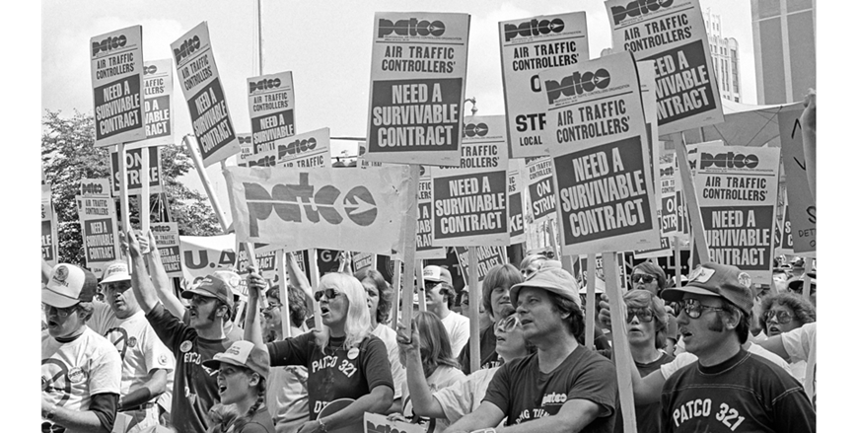
Power to Execute the Law
President Ronald Reagan exercised his power to enforce federal laws in 1981 by firing striking air traffic controllers. The strike was illegal according to a 1955 law passed by Congress.
Notes:
the Constitution requires the President to execute all federal laws, no matter what the chief executive’s own views of any of them may be. Their number, and the many subjects they cover, nearly boggle the mind. Social security, gun control, affirmative action, immigration, minimum wages, terrorism, environmental protection, taxes—these only begin the list. There are scores of others.
The President—and, importantly, the President’s subordinates—have much to say about the meaning of laws, as do Congress and the courts. In executing and enforcing law, the executive branch also interprets it.

Slide 6
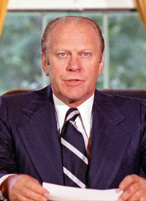
President’s Judicial Powers
The President has been given certain judicial powers. Specifically, the Constitution gives the President the power to
“. . . Grant Reprieves and Pardons for Offenses against the United States, except in Cases of Impeachment.”
—Article II, Section 2, Clause 1
A reprieve is the postponement of the execution of a sentence. A pardon is legal forgiveness of a crime.
These powers of clemency (mercy or leniency) may be used only in cases involving federal offenses.
In his pardon of Richard Nixon, President Ford referred to Watergate, saying, "My conscience tells me that only I, as President, have the constitutional power to firmly shut and seal this book."
Notes:
The President’s power to grant reprieves and pardons is absolute, except in cases of impeachment, where they may never be granted.
Pardons in advance of a trial or charge are rare. The most noteworthy pardon, by far, was granted in 1974. In that year, President Gerald Ford gave “a full, free and absolute pardon unto Richard Nixon for all offenses against the United States which he . . . has committed or may have committed or taken part in during the period from January 20, 1969, through August 9, 1974.” Of course, that pardon referred to the Watergate scandal.
To be effective, a pardon must be accepted by the person to whom it is granted. When a pardon is granted prior to a charge or conviction, as in the Nixon case, its acceptance is regularly seen as an admission of guilt by the person to whom it is given.
Nearly all pardons are accepted, of course, and usually gratefully. A few have been rejected, however. One of the most dramatic refusals led to a Supreme Court case, Burdick v. United States, 1915. George Burdick, a New York newspaper editor, had refused to testify before a federal grand jury regarding the sources for certain news stories his paper had printed.
Those stories reported fraud in the collection of customs duties. He invoked the 5th Amendment, claiming that his testimony could incriminate him. President Woodrow Wilson then granted Burdick “a full and unconditional pardon for all offenses against the United States” that he might have committed in obtaining material for the news stories.
Interestingly, Burdick refused to accept the pardon, and he continued to refuse to testify. With that, the federal judge in that district fined and jailed him for contempt. The judge ruled that (1) the President’s pardon was fully effective, with or without Burdick’s acceptance and (2) there was, therefore, no basis for Burdick’s continued claim of protection against self-incrimination.
The Supreme Court overturned the lower court’s action. It unanimously upheld the rule that a pardon must be accepted in order to be effective, and it ordered Burdick’s release from jail.

Slide 7
President’s Judicial Powers
The pardoning power includes the power of commutation, or the power to reduce a fine or the length of a sentence imposed by a court.
The pardoning power also includes the power of amnesty, which is in effect a blanket pardon offered to a group of law violators.
Some protestors burned their draft cards to show their opposition to the Vietnam War.
Notes:
The pardoning power includes the power to grant conditional pardons, provided the conditions are reasonable.
Thus, in 1893, President Benjamin Harrison issued a proclamation of amnesty forgiving all Mormons who had violated the antipolygamy (multiple marriage) laws in the federal territories. And in 1977, President Jimmy Carter granted amnesty to those who evaded the draft during the war in Vietnam.

Slide 8
Powers of Appointment and Removal
A President cannot hope to succeed without loyal subordinates who support the policies of the President’s administration. To that end, the Constitution says that the President…
“by and with the Advice and Consent of the Senate . . . shall appoint Ambassadors, other public Ministers and Consuls, Judges of the supreme Court, and all other Officers of the United States, whose Appointments are not herein otherwise provided for . . .but the Congress may by Law vest the Appointment of such inferior Officers, as they think proper, in the President alone, in the Courts of Law, or in the Heads of Departments.”
—Article II, Section 2, Clause 2
Notes:
The job of administering and applying most federal law is the day-to-day work of all of the many departments, commissions, and other agencies of the Federal Government. All of the some 2.7 million civilian men and women who staff those agencies are subject to the President’s control and direction.

Slide 9
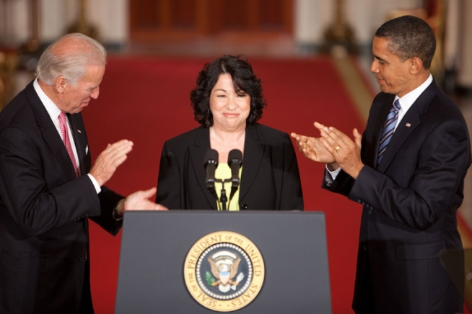
Powers of Appointment and Removal
The President names most of the top-ranking officers of the Federal Government. Among them are
(1) ambassadors and other diplomats
(2) Cabinet members and their top aides
(3) the heads of independent agencies
(4) all federal judges, U.S. marshals, and attorneys
(5) all officers in the armed forces

Slide 10
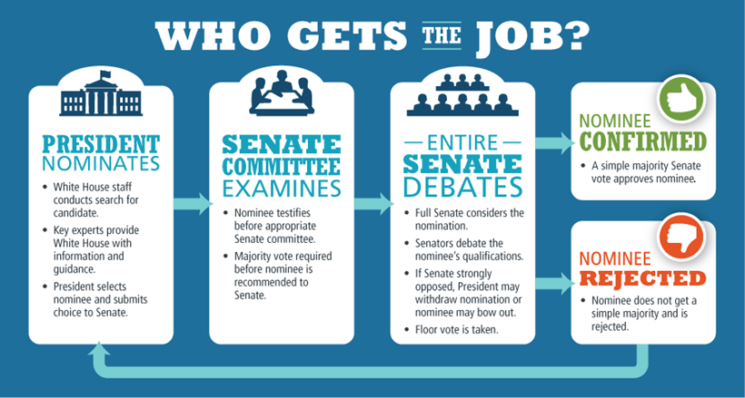
Notes:
Why is this multi-step process necessary?

Slide 11
Powers of Appointment and Removal
Senatorial courtesy: that the Senate will approve only those federal appointees acceptable to the senator or senators of the President’s party from the State involved.
The Constitution does allow the President to make “recess appointments,” that is, appointments “to fill up all Vacancies that may happen during the Recess of the Senate” (Article II, Section 2, Clause 3).
Any such appointment automatically expires at the end of the congressional term in which it is made.
Notes:
The power to remove is the other side of the appointment coin, and is as important to presidential success as is the power to appoint. Yet, except for mention of the little-used impeachment process, the Constitution says nothing about how, by whom, or why an appointed officer may be dismissed.
The matter was hotly debated in the first session of Congress, in 1789. Several members argued that, if an appointment required Senate approval, Senate consent should also be required for removal. They insisted that this restriction on presidential authority was essential to congressional supervision (oversight) of the executive branch. But others argued that the President could not “take Care that the Laws be faithfully executed” without a free hand to dismiss those who were incompetent or otherwise unsuited to office.
The latter view prevailed. The First Congress gave the President the power to remove any officer he appointed, except federal judges. Over the years since then, Congress has sometimes tried, with little success, to restrict the President’s freedom to dismiss.
One notable instance occurred in 1867. Locked with Andrew Johnson in the fight over Reconstruction, Congress passed the Tenure of Office Act. That law’s plain purpose was to prevent President Johnson from removing several top officers in his administration, in particular the secretary of war, Edwin M. Stanton. The law provided that any person holding an office by presidential appointment with Senate consent should remain in that office until a successor had been confirmed by the Senate.
The President vetoed the bill, charging that it was an unconstitutional invasion of executive authority. The veto was overridden, but Mr. Johnson ignored Congress and fired Stanton anyway. The veto and Stanton’s removal sparked the move for Johnson’s impeachment. Ultimately, the President was acquitted, and the law was ignored in practice. It was finally repealed in 1887.
Removal and the Court The question of the President’s removal power did not reach the Supreme Court until Myers v. United States, 1926. In 1876, Congress had passed a law requiring Senate consent before the President could dismiss any first-class, second-class, or third-class postmaster.
In 1920, without consulting the Senate, President Woodrow Wilson removed Frank Myers as the postmaster at Portland, Oregon. The deposed postmaster then sued for the salary for the rest of his four-year term. He based his claim on the point that he had been removed in violation of the 1876 law.
The Court, led by a former President, Chief Justice Taft, found the law unconstitutional. It held that the removal power was an essential part of executive power, clearly necessary to the faithful execution of the laws.
The Supreme Court did place some limits on the President’s removal power in 1935, in Humphrey’s Executor v. United States. President Herbert Hoover had appointed William Humphrey to a seven-year term on the Federal Trade Commission (FTC) in 1931. When Franklin D. Roosevelt took office in 1933, he found Commissioner Humphrey to be in sharp disagreement with many of his policies. He asked the commissioner to resign, saying that his administration would be better served with someone else on the FTC. When Mr. Humphrey refused, President Roosevelt removed him. Humphrey soon died, but his heirs filed a suit for back salary.
The Supreme Court upheld the heirs’ claim. It based its decision on the act creating the FTC. That law provides that a member of the commission may be removed only for “inefficiency, neglect of duty, or malfeasance in office.”
The Court further held that Congress does have the power to set the conditions under which a member of the FTC and other such agencies might be removed by the President. It did so because those agencies, the independent regulatory commissions, are not purely executive agencies.

Slide 12
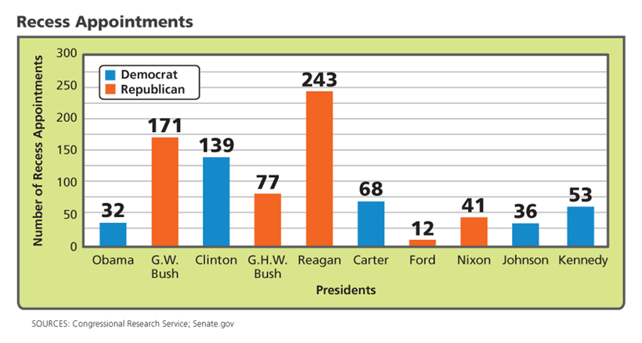
Notes:
Do recess appointments shift the balance of power in the government?

Slide 13
President’s Legislative Powers
Remember, the Constitution presents the President with four options once a measure has been approved by Congress. He/she can …
(1) sign the bill into law
(2) veto the bill, and the measure must then be returned to Congress.
(3) allow a bill to become law by not acting on it, neither signing nor vetoing it, within ten days.
(4) use the pocket veto, can be used only at the end of a congressional session. If Congress adjourns within ten days (not counting Sundays) of sending a bill to the White House and the President does not act on it, the measure dies.
Notes:
Thomas Jefferson wrote this to a friend in 1789: “The execution of the laws is more important than the making of them.” Whether Jefferson was right about that or not, in this section you will see that the President’s power to execute the law endows the chief executive with extraordinary authority.
In The Federalist No. 51, James Madison analyzes the Constitution’s elaborate system of checks and balances. Its “constant aim,” he says, “is to divide and arrange the several [branches] in such a manner as that each may be a check on the other.” And, he adds, “the great security against a gradual concentration of the several powers in the same department consists in giving to those who administer each department the necessary constitutional means and personal motives to resist encroachments of the others. . . . ”
The word veto comes from the Latin meaning "I forbid." Congress can then override that veto, by a two-thirds vote in each of its two chambers, but it seldom does.

Slide 14
12
9
Notes:
How can Congress check the President’s veto power?

Slide 15
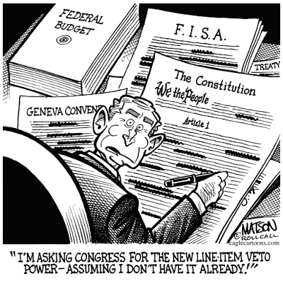
President’s Legislative Powers
Signing Statements: various Presidents have issued “signing statements” about how they’ll enforce a law as they sign it.
The Line-Item Veto: The President can reject parts of a spending bill. If the President decides to veto a bill, he must reject the entire measure. He cannot veto only a portion of it. → unconstitutional!
Notes:
President George W. Bush stirred controversy by issuing signing statements more often than any of his predecessors, attaching them to more than 700 of the bills he signed. In doing so, he claimed a power, on one hand, to refuse to enforce those provisions or, on the other, to interpret them “in a manner consistent with” his view of “the constitutional authority of the President.”
His critics claim that Mr. Bush, in effect, used these statements as a substitute for the veto power, deciding which new laws he would execute and how those laws would be interpreted and applied. Defenders argue that signing statements have been used by Presidents throughout the nation's history, that they are an important means for the President to express his reservations about a piece of legislation, and that the national security issues that arose during the Bush administration warranted any increased use.
President Obama has generally rejected his predecessor’s view of signing statements. He has used them sparingly, in much the same way that earlier chief executives have.
On occasion, those statements were used to point out constitutional or other problems the President saw in a newly enacted law.
More often, the statements have been used to do such things as to direct the manner in which a new law is to be enforced.
Line item veto: Most often, those who have proposed this device would restrict its application to specific dollar amounts (line items) in spending bills enacted by Congress. Many supporters argue that the line-item veto would be a potent weapon against wasteful and unnecessary federal spending.
Opponents of the line-item veto have long argued that the move would bring a massive and dangerous shift of power from the legislative branch to the executive branch. To this point, efforts to persuade Congress to propose a line-item veto amendment to the Constitution have failed.
In 1996, Congress did pass a Line-Item Veto Act. The Supreme Court struck it down, however, holding that Congress lacked the power to give the President a line-item veto, in Clinton v. New York City, 1998. If the chief executive is to have that authority, said the Court, it can come only as the result of an amendment to the Constitution.

Slide 16
Executive Orders
The chief executive has the power to issue executive orders, which are directives, rules, or regulations that have the effect of law.
The Power of Executive Privilege: the nation’s chief executives have at times insisted that the Constitution gives the President executive privilege, or the inherent power to refuse to disclose certain information to Congress or to the federal courts.
US v. Nixon → Supreme Court ruled that there IS executive privilege
Notes:
The power to issue these orders, the ordinance power, arises from two sources: the Constitution and acts of Congress.
The Constitution does not mention the ordinance power in so many words, but that power is clearly intended. In granting certain powers to the President, the Constitution obviously anticipates their use. In order to exercise those powers, the chief executive must have the power to issue the necessary orders, and, as well, the power to implement them.
Beginning with George Washington in 1796, the nation’s chief executives have at times insisted that the Constitution gives the President the inherent power to refuse to disclose certain information to Congress or to the federal courts. That is, they have claimed the power of executive privilege. Most often, a claim of executive privilege has been made with regard to conversations and other communications between Presidents and their closest advisors.
Congress has never recognized executive privilege. It has often tried to compel executive officials to testify at congressional committee hearings, and Presidents have frequently resisted those efforts, citing executive privilege.
the Supreme Court has recognized both the existence of and the need for executive privilege in a historic case, United States v. Nixon, in 1974. There, a unanimous Court said that although the President might legitimately claim executive privilege in matters involving national security, that privilege cannot be used to prevent evidence from being heard in a criminal proceeding. This decision was a key factor in Mr. Nixon’s resignation.

Slide 17
Treaties
Definition: a formal agreement between countries that, like laws, must be followed.
The President is responsible for negotiating and signing treaties.
All treaties must be approved by 2/3rds of the Senate.
Example: Countries form an alliance through signing a treaty. This treaty says that if one of the countries is attacked, the others will step in to protect each other.
An Agreement is less formal and doesn’t need the consent of the Senate
Notes:
Comprehensive market access. The TPP eliminates or reduces tariff and non-tariff barriers across substantially all trade in goods and services and covers the full spectrum of trade, including goods and services trade and investment, so as to create new opportunities and benefits for our businesses, workers, and consumers.
Regional approach to commitments. The TPP facilitates the development of production and supply chains, and seamless trade, enhancing efficiency and supporting our goal of creating and supporting jobs, raising living standards, enhancing conservation efforts, and facilitating cross-border integration, as well as opening domestic markets.
Addressing new trade challenges. The TPP promotes innovation, productivity, and competitiveness by addressing new issues, including the development of the digital economy, and the role of state-owned enterprises in the global economy.
Inclusive trade. The TPP includes new elements that seek to ensure that economies at all levels of development and businesses of all sizes can benefit from trade. It includes commitments to help small- and medium-sized businesses understand the Agreement, take advantage of its opportunities, and bring their unique challenges to the attention of the TPP governments. It also includes specific commitments on development and trade capacity building, to ensure that all Parties are able to meet the commitments in the Agreement and take full advantage of its benefits.
Platform for regional integration. The TPP is intended as a platform for regional economic integration and designed to include additional economies across the Asia-Pacific region.
1. Secret Negotiations With Corporate Lobbyists
In drafting the TPP, government negotiators bowed to corporate influence, locking in policies to lower tariffs and regulations that will boost their profits. The deal was then negotiated in secret between the United States, Australia, Brunei, Canada, Chile, Japan, Malaysia, Mexico, New Zealand, Peru, Singapore, and Vietnam.
What’s worse is that 600 corporate lobbyists were asked to give input on the deal while civil society — that’s you and me — was left out.
Why all the secrecy?
2. The TPP Means Dead Sharks, Tigers, and Elephants
The TPP is all about reducing tariffs and taxes on imports, regardless of the consequences. Thanks to research by Ben Beachy of the Sierra Club, we know that this includes tariffs on shark fins, palm oil — whose expanding plantations threaten tiger habitat — and even ivory.
Cheaper shark fins means more dead sharks and cheaper palm oil means more rainforests cleared for plantations. The tariff reductions on legal ivory could even spur popularity and demand for illegally poached elephant ivory .
3. The TPP Gives a Future to Fracking
The TPP will also make it much easier for the United States to export natural gas from fracking.
Right now, exporting natural gas needs approval from the Department of Energy. The TPP removes any significant review of the environmental consequences by making approval automatic. And when export markets are guaranteed, fossil fuel companies in the United States will build more natural gas export facilities, infrastructure that will guarantee fracking, drive climate change, and poison our water for years to come.
4. The TPP Gives Corporations Too Much Power
Under the TPP, corporate polluters will be able to sue the United States when they don’t get what they want. Corporations are already doing everything they can to buy influence in our democracy and use their dollars to drown out the voice of the people — the last thing they need is more influence over government.
If the United States passes environmental regulations that hurt a foreign corporation’s bottom line, that company will be able to sue us in a secret a foreign tribunal whose decision is final and unappealable.
Right now, Transcanada is using similar rules under the North American Free Trade Agreement (NAFTA) to sue the United States for prohibiting the expansion of the Keystone XL tar sands pipeline. Under the TPP, we could see thousands of similar lawsuits designed to reverse environmental progress.

Slide 18
Rank the tasks in the list from 1 (hardest) to 4 (easiest). There is no correct answer! Use your own judgment.
____ lead weekly meetings where I ask the leaders of the executive departments for advice on how to handle the county’s problems.
____ choose a new Supreme Court justice to replace one who is retiring.
____ follow the Constitution even if they disagree with it.
____ Try and negotiate a treaty with another country that would lower the import taxes each one adds.

Slide 19
Who does what?
The Constitution, the rulebook for the government, says who has which foreign policy powers. Using your notes, see if you can figure out who is responsible for which power:
Negotiates and signs treaties.
Must approve treaties by a 2/3 majority.
Makes recommendations on and signs or vetoes bills into law.
As Commander-in-Chief, can send troops around the world.
Writes and passes bills.
Declares war.

Slide 20
Review: can the President…
Defend and protect the Constitution
Draft laws and pass them
Commander in Chief of the armed forces
Decide who wins court cases
Execute laws that have been passed
Tell Congress what laws it must pass
Recommend laws for Congress to consider
Ask for advice from department heads
Cast a tiebreaking vote in the Senate
Notes:
After working through the reading pages with the class, read each of the following presidential powers out loud. Have the class respond as a group by…
• Saying “yes” or “no” as a chorus
• Showing thumbs-up for yes and thumbs down for no
Watch or listen for wrong or mixed . Use each power as a springboard for quick review/discussion before moving on.
YES
NO
YES
NO
YES
NO
YES
YES
NO

Slide 21
Review: can the President…
Make treaties without approval
Nominate Supreme Court judges
Nominate ambassadors
Run for a third term in office
Appoint a governor for each state
Approve or reject laws that have been passed
Pardon a politician who has been impeached
Receive ambassadors from other countries
Give information to Congress about the State of the Union
Notes:
10. NO
11. YES
12. YES
13. NO
14. NO
15. YES
16. NO
17. YES
18. YES

Slide 22
Presidential Roles
The following are a mixture of historical and fictional scenarios that involve the roles of the president. Read each scenario and discuss with a neighbor which role the president is fulfilling and justify your answer with evidence.

Slide 23
Chief Executive
Following Justice David Souter’s retirement from the Supreme Court in 2009, President Barack Obama appointed Sonia Sotomayor to the Supreme Court with the Senate’s approval.

Slide 24
Commander-in-Chief
2. Despite the fact that there is no Congressional declaration of war, you, as the President of the United States decide to send troops to a country to help civilians in need.

Slide 25
Chief of State
3. In May of 2007, President George W. Bush welcomed British Prime Minister Tony Blair to the White House.

Slide 26
Chief Citizen
4. While creating next year’s federal budget, the president decides to increase spending on education and to decrease spending on the military.

Slide 27
Chief of Party
5. This is the president’s last year in office, and he would like to make sure that a member of his party is elected for the next presidential term. As a result, he decides to speak on behalf of one of his party’s presidential nominees at a fundraising event.

Slide 28
Chief Legislator
6. On December 19, 1995, President Bill Clinton vetoed H.R. 1058 Private Securities Litigation Reform Act. However, it was overridden by a 2/3 vote in both houses of Congress and enacted as Public Law 104-67.

Slide 29
Chief Diplomat
7. The president negotiates a treaty with surrounding countries regarding the protection of endangered wildlife. The Senate approves this treaty.

Slide 30
Chief Executive
8. Colin Powell was nominated as Secretary of State by President George W. Bush and approved unanimously by the Senate.

Slide 31
Commander-in-Chief
9. After the bombing of Pearl Harbor, President Franklin D. Roosevelt requested a declaration of war, which Congress approved. President Harry S. Truman later ordered the bombing of Hiroshima.

Slide 32
Chief Legislator
10. The president decides to propose a bill on energy conservation. The bill is drafted and arrives needing approval. After signing the bill, it becomes a law.

Slide 33
Warm-up
What is one way that can Congress check presidential power?
In your opinion, who has more economic power, Congress or the President? Explain.
In your opinion, are executive orders essential for the president to fulfill the duties of the office? Explain.

Slide 34
Stations
STATION # | POWER | SUMMARIZE THE DOCUMENT, WHERE THE POWER IN IN CONSTITUTION? | IN YOUR OPINION, IS THIS A CONSTITUTIONAL USE OF POWER? EXPLAIN
1
2
3
4
5
6
7

Slide 35
Stations
STATION # | POWER | SUMMARIZE THE DOCUMENT, WHERE THE POWER IN IN CONSTITUTION? | IN YOUR OPINION, IS THIS A CONSTITUTIONAL USE OF POWER? EXPLAIN
1 | Executive Order | Article 2 section 2 → implied power from this section
2 | Treaties and Agreements | Article 2 section 2 → expressed power from this section
3 | Presidential Pardon | Article 2 section 2 → expressed power from this section
4 | Veto power | Article 1 section 7 → expressed power, but it’s in the article about Congress
5 | Appointment power | Article 2 section 2 → expressed power from this section
6 | Signing Statement | It’s not really in the Constitution
7 | War Powers | Article 2 section 2 → expressed power from this section

